Slide 1
INSTALLING & CONFIGURING SERVERS

Slide 2
INSTALLING WINDOWS SERVER 2012

Slide 3
Overview
Using server core
Server core defaults
Server core capabilities
Using the minimal server interface
Upgrade paths
Preparing to upgrade installation
Installing windows server migration tools
Supported operating systems
Supported Editions
Installing Windows Server Migration Tools
Points to Ponder

Slide 4
Using server core
Windows Server 2012 R2 includes an installation option that minimizes the user interface on a server.
When you select the Windows Server Core installation option, you will install a stripped-down version of the operating system.
There is no Start menu, no desktop Explorer shell, no Microsoft Management Console (MMC), and virtually no graphical applications.

Slide 5
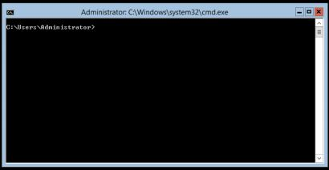
Using server core (Contd.,)
Fig: The default Server Core interface

Slide 6
Using server core (Contd.,)
Hardware resource conservation Server Core eliminates some of the most
memory-intensive and processor-intensive elements of the Windows Server 2012 R2
operating system.
Reduced disk space Server Core requires less disk space for the installed operating
system elements and less swap space.
Reduced patch frequency The graphical elements of Windows Server 2012 R2 are
among the most frequently updated, so running Server Core reduces the number of
updates that administrators must apply.
Reduced attack surface The less software there is running on the computer, the
fewer entrance points for attackers to exploit. Server Core reduces the potential
openings presented by the operating system, increasing its overall security.

Slide 7
Server core defaults
In Windows Server 2012 R2, Server Core is the default installation option for reasons other than simply providing administrators with the ability to switch options after installing.
Windows Server 2012 R2, for the first time, includes comprehensive remote administration tools that nearly eliminate the need to work at the server console.

Slide 8
Server core defaults (Contd.,)
The new Server Manager application in Windows Server 2012 R2 enables administrators to add servers from all over the enterprise and create server groups to facilitate the simultaneous configuration of multiple systems.
The new Windows PowerShell 4.0 environment increases the number of available cmdlets from 230 to well over 2,000.

Slide 9
Server core capabilities
A Server Core installation omits some of the server roles found in a Server with a GUI installation. However, the Server Core option in Windows Server 2012 R2 includes 12 of the 19 roles, plus support for SQL Server 2012, as opposed to only 10 roles in Windows Server 2008 R2 and nine in Windows Server 2008.

Slide 10
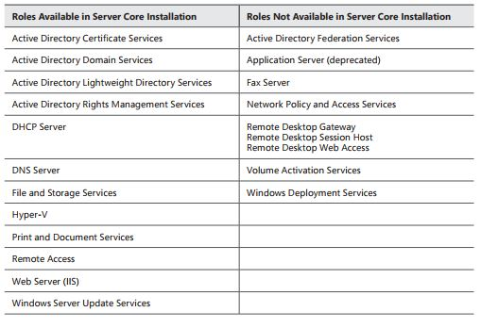
Server core capabilities (Contd.,)
Table: Windows Server 2012 R2 Server Core roles

Slide 11
Using the minimal server interface
The Minimal Server Interface is a setting that removes some of the most hardware intensive elements from the graphical interface.
These elements include Internet Explorer and the components of the Windows shell, including the desktop, File Explorer, and the Windows 8 desktop apps.

Slide 12
Using the minimal server interface (Contd.,)
Also omitted are the Control Panel items implemented as shell extensions, including the following:
Programs and Features
Network and Sharing
Devices and Printers Center
Display
Firewall
Windows Update
Fonts
Storage Spaces

Slide 13
Using the minimal server interface (Contd.,)
What’s left in the Minimal Server Interface are the Server Manager application, the MMC application, Device Manager, and the entire Windows PowerShell interface.
This provides administrators with most of the tools they need to manage local and remote servers.
To configure a Windows Server 2012 R2 Server with a GUI installation to use the Minimal Server Interface, you must remove the Server Graphical Shell feature by using Windows PowerShell or the Remove Roles And Features Wizard.

Slide 14
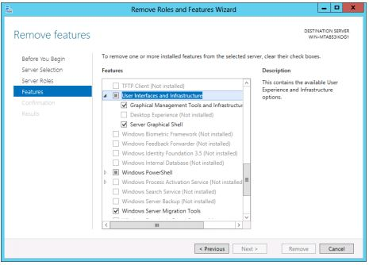
Using the minimal server interface (Contd.,)
Fig: Using the User Interfaces And Infrastructure feature in the Remove Roles And Features Wizard

Slide 15
Upgrade paths
Upgrade paths for Windows Server 2012 R2 are limited. In fact, it’s easier to specify when you can perform an upgrade than when you can’t.
If you have a 64-bit computer running Windows Server 2008 or Windows Server 2008 R2, you can upgrade it to Windows Server 2012 R2 as long as you use an appropriate operating system edition.

Slide 16
Upgrade paths (Contd.,)
Windows Server 2012 R2 does not support the following:
Upgrades from Windows Server versions prior to Windows Server 2008
Upgrades from pre-RTM editions of Windows Server 2012 R2
Upgrades from Windows workstation operating systems
Cross-platform upgrades, such as 32-bit Windows Server 2008 to 64-bit Windows Server 2012 R2
Upgrades from any Itanium edition
Cross-language upgrades, such as from Windows Server 2008, U.S. English to Windows Server 2012 R2, French
In any of these cases, the Windows Setup program will not permit the upgrade to proceed.
Notes:
RTM - Release To Manufacturing
First of all lets clear that IA64 and x64 are not same! Both are different processor architectures. IA64 also known as Itanium-based system is a processor architecture specifically developed for Server operating systems. IA64 stands for Intel Itanium Architecture 64. It was originally developed by the popular HP (Hewlett-Packard) company and later Intel also joined HP in the development of this processor architecture.
IA64 was developed for Enterprise servers and high-performance computer systems but it didn't work well as expected. The main problem in IA64 was the lack of support for older x86 (32-bit) programs. It was not able to run older x86 programs properly.
On the other hand, x64 (64-bit) architecture can run both x86 as well as x64 programs without any problem. x64 is actually a 64-bit extension of the older x86 architecture.
Almost all new Desktop PCs and laptops come with x64 (64-bit) processor architecture. You'll never find IA64 or Itanium-based processor in any normal computer. IA64 was last supported in Windows XP and Windows Server 2008 R2 operating systems as Microsoft developed special editions of Windows OS for IA64 processor architecture. Newer Windows versions do not support IA64 architecture as Microsoft decided to end support for it long time back.

Slide 17
Preparing to upgrade installation
Before you begin an upgrade to Windows Server 2012 R2, you should perform a number of preliminary procedures to ensure that the process goes smoothly and that the server data is protected.

Slide 18
Preparing to upgrade installation (Contd.,)
Consider the following before you perform any upgrade to Windows Server 2012 R2:
Check hardware compatibility
Check disk space
Save mass storage drivers on removable media
Check application compatibility
Ensure computer functionality
Perform a full backup
Disable virus protection software
Disconnect the UPS device
Purchase the correct Windows Server 2012 R2 edition

Slide 19
Installing windows server migration tools
Migrating roles
Migration is the preferred method of replacing an existing server with one running Windows Server 2012 R2.
Unlike an in-place upgrade, a migration copies vital information from an existing server to a clean Windows Server 2012 R2 installation.
Administrators can use Windows Server Migration Tools to migrate server roles, features, operating system settings, and other data and shares to computers that are running Windows Server

Slide 20
Installing windows server migration tools (Contd.,)
Windows Server 2012 R2, you can migrate data between servers under any of the following conditions:
Between versions You can migrate data from any Windows Server version from Windows Server 2003 SP2 to Windows Server 2012 R2. This includes migrations from one server running Windows Server 2012 R2 to another.
Between platforms You can migrate data from a 32-bit or 64-bit server to a 64-bit server running Windows Server 2012 R2.

Slide 21
Installing windows server migration tools (Contd.,)
Between editions You can migrate data between servers running different Windows Server editions.
Between physical and virtual instances You can migrate data from a physical server to a virtual one, or the reverse.
Between installation options You can migrate data from one server to another, even when one server is using the Server Core installation option and the other is using the Server with a GUI option.

Slide 22
Supported Editions
The following editions of Windows Server are supported as either source or destination servers:
Windows Server Foundation
Windows Server Standard
Windows Server Enterprise
Windows Server Datacenter

Slide 23
Installing Windows Server Migration Tools
There are 2 way of installing these tools on your Windows Server 2012 server.
Powershell
Add Roles and Features Wizard

Slide 24
Installing Windows Server Migration Tools (Contd.,)
Using Powershell
Use PowerShell by opening a Windows PowerShell command window as administrator.
Install-WindowsFeature Migration –ComputerName

Slide 25
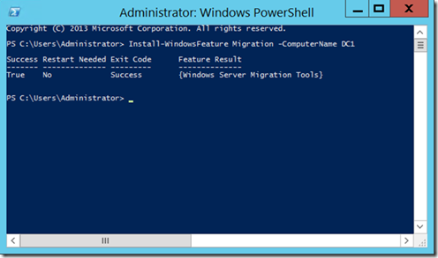
Installing Windows Server Migration Tools (Contd.,)
Fig: Installing Windows Server Migration Tools via Powershell

Slide 26
Installing Windows Server Migration Tools (Contd.,)
Using Add Roles and Features Wizard
Use the “Add Roles and Features Wizard” to add the Windows Server Migration Tools to your destination machine.

Slide 27
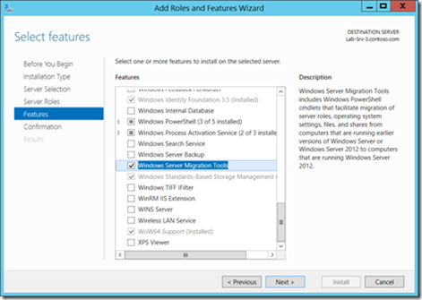
Installing Windows Server Migration Tools (Contd.,)
Fig: Installing Windows Server Migration Tools via Add Roles and Features Wizard

Slide 28
Points to remember…
When using the Windows Server Migration Tools, it is important to understand the following points:
You should be familiar with using PowerShell and Server Manager.
Features must be installed on both source and destination computers.
Source operating system must be at least Windows Server 2003 (x86 or x64).
Server Core 2008 R2 is supported as a source operating system.
The destination will support Server 2012 R2 full and Core (x64) installation options.
Supports both physical and virtual servers.
Migration between different language installations is not supported.

Slide 29
Thank you

